Slide 1

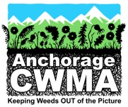

Mayday, Mayday – Alien trees are invading Alaska’s forests
Tim Stallard and Sue Salmons
Alien Species Control, LLC (Contractors for Anchorage Park Foundation)
Gino Graziano
UAF Cooperative Extension Service

Slide 2
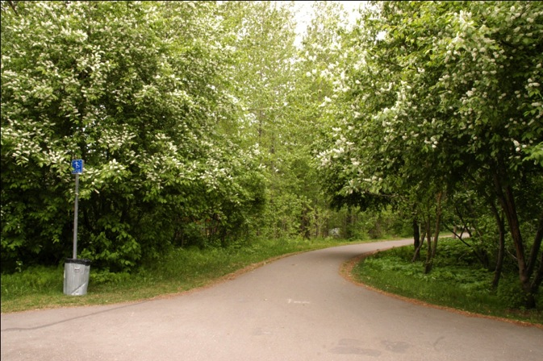
Executive Order 13112 defines invasive species as "…an alien (or non-native) species whose introduction does, or is likely to cause economic or environmental harm or harm to human health".
Only a small proportion of introduced species are invasive

Slide 3
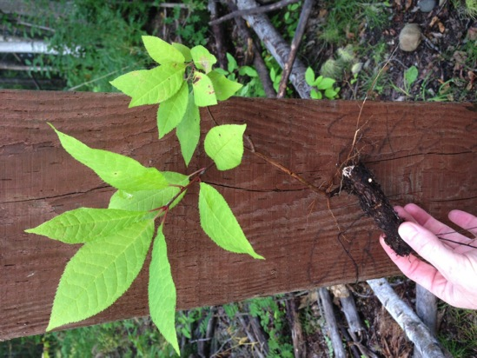
European bird cherry
Prunus padus
Native to northern Europe and Asia
Introduced as an ornamental tree - No longer planted by MOA nor by informed citizens
Produces sour cherries that are spread by birds.
Vegetative reproduction by root and stem sprouts

Slide 4
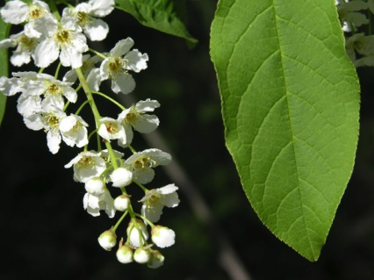
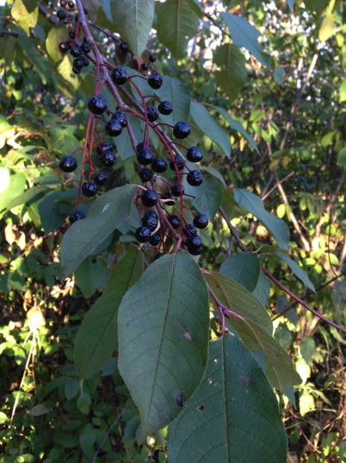
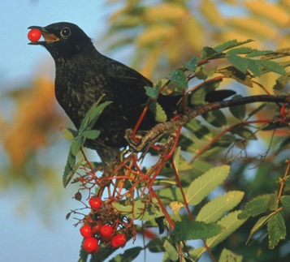
October 14, 2014

Slide 5
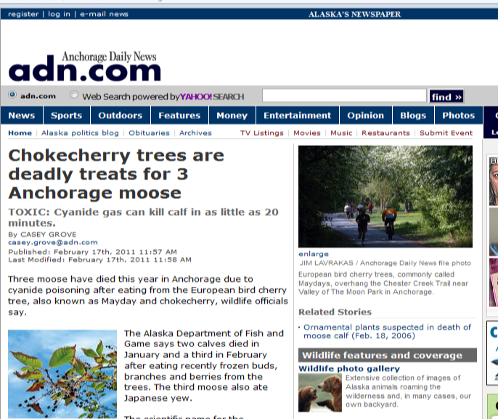
Mayday: Highly invasive in Alaska
Ranked 76 out of 100
Crowds out native plants and forms dense monocultures
Threatens food for moose and salmon
In rare situations, can poison moose

Slide 6
Notes:
Where is it now
What if don’t do anything??

Slide 7
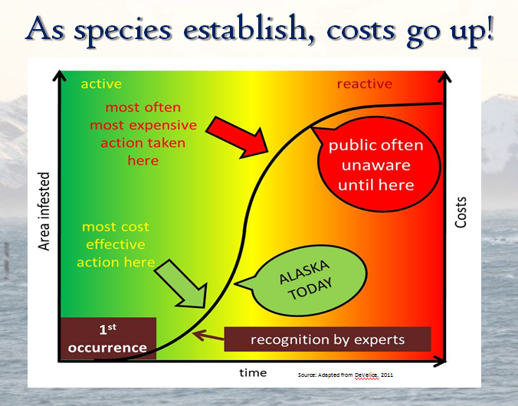

Slide 8
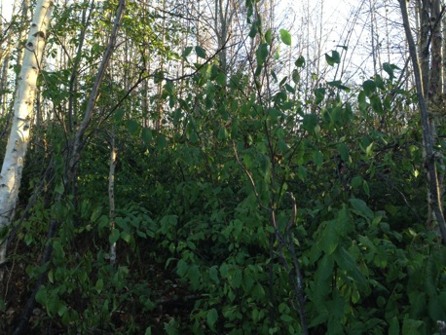
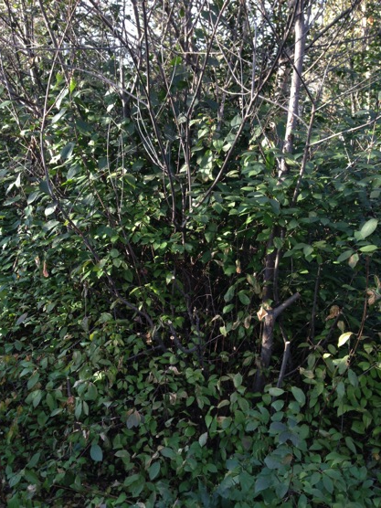
Taking over a forest near you

Slide 9
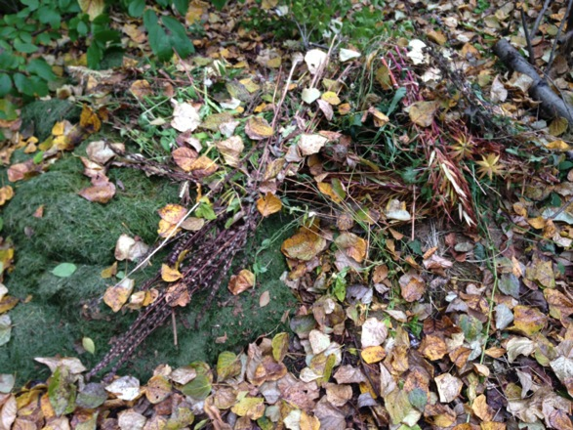
What can we do? The IPM Options:
Prevention
  Best approach, but challenging to implement
  Discourage sale
Manual removal
Mechanical
Chemical

Slide 10
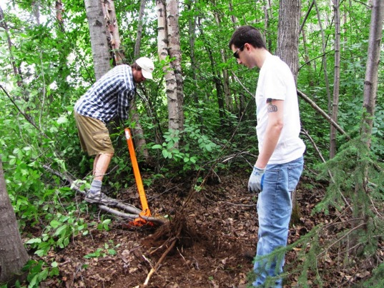
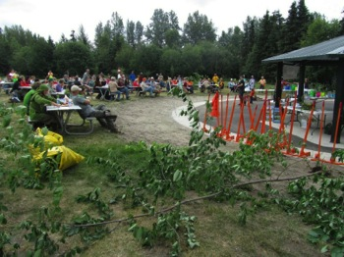
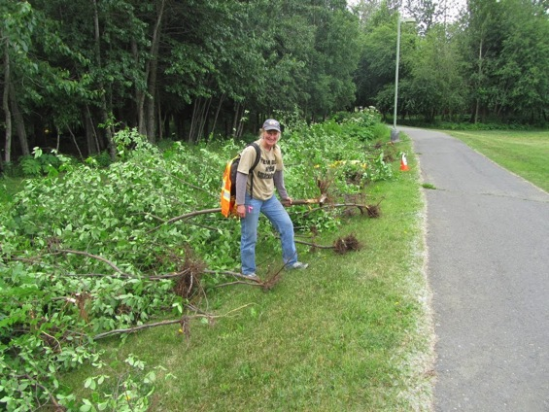
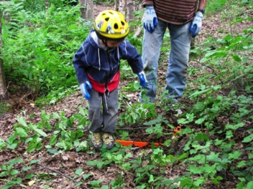
Manual Removal
Effective on smaller trees, new infestations

Slide 11
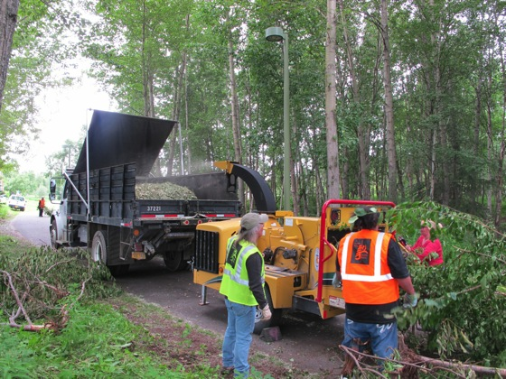
Mechanical Control
Counter productive – stimulates additional growth
Stumps sprout
Roots sucker
Cut branches left behind can sprout new trees

Slide 12
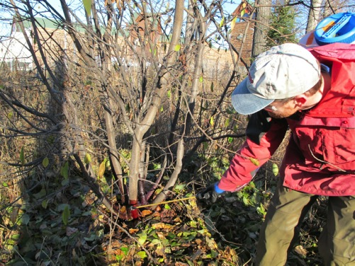
Herbicide Control
Only effective option for mature trees because it kills the roots
Cost and labor efficient
Very low risk options, applied directly to target plants
Garlon 4 Ultra (triclopyr) – very effective on woody brush – diluted with vegetable oil
2010 UAA Alaska Natural Heritage Program study recommended management begin with control of mature, fruit producing trees with DEC approved herbicides.

Slide 13
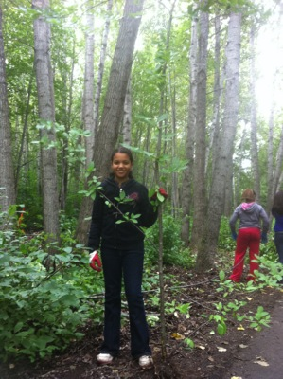
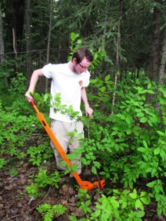
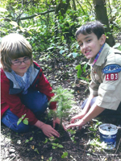
Proposed 2015 project for Chester GB
Direct herbicide treatments to mature target trees by Tim Stallard and staff while trail is closed.
Manual removal and spruce seedling planting w/ community volunteers.

Slide 14
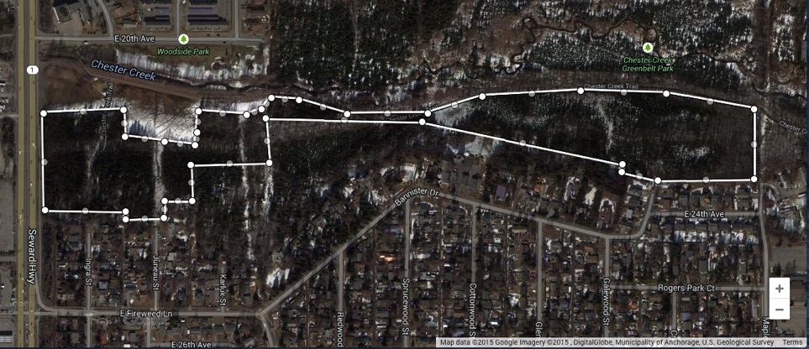
2015 Rogers Park – bird cherry control
Chester Creek Greenbelt - forested area south of trail

Slide 15
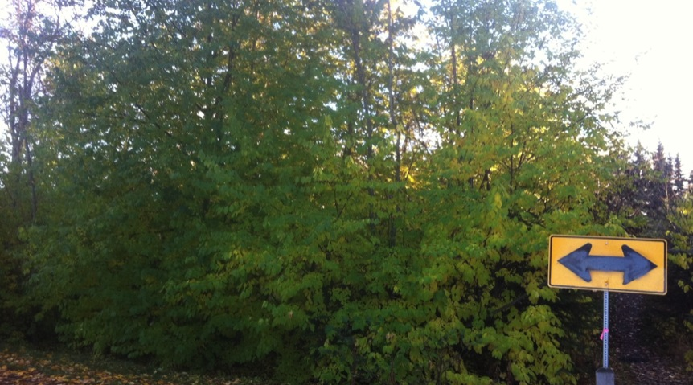
Where do we go from here?
Questions
Comments
Resolution

